Slide 1
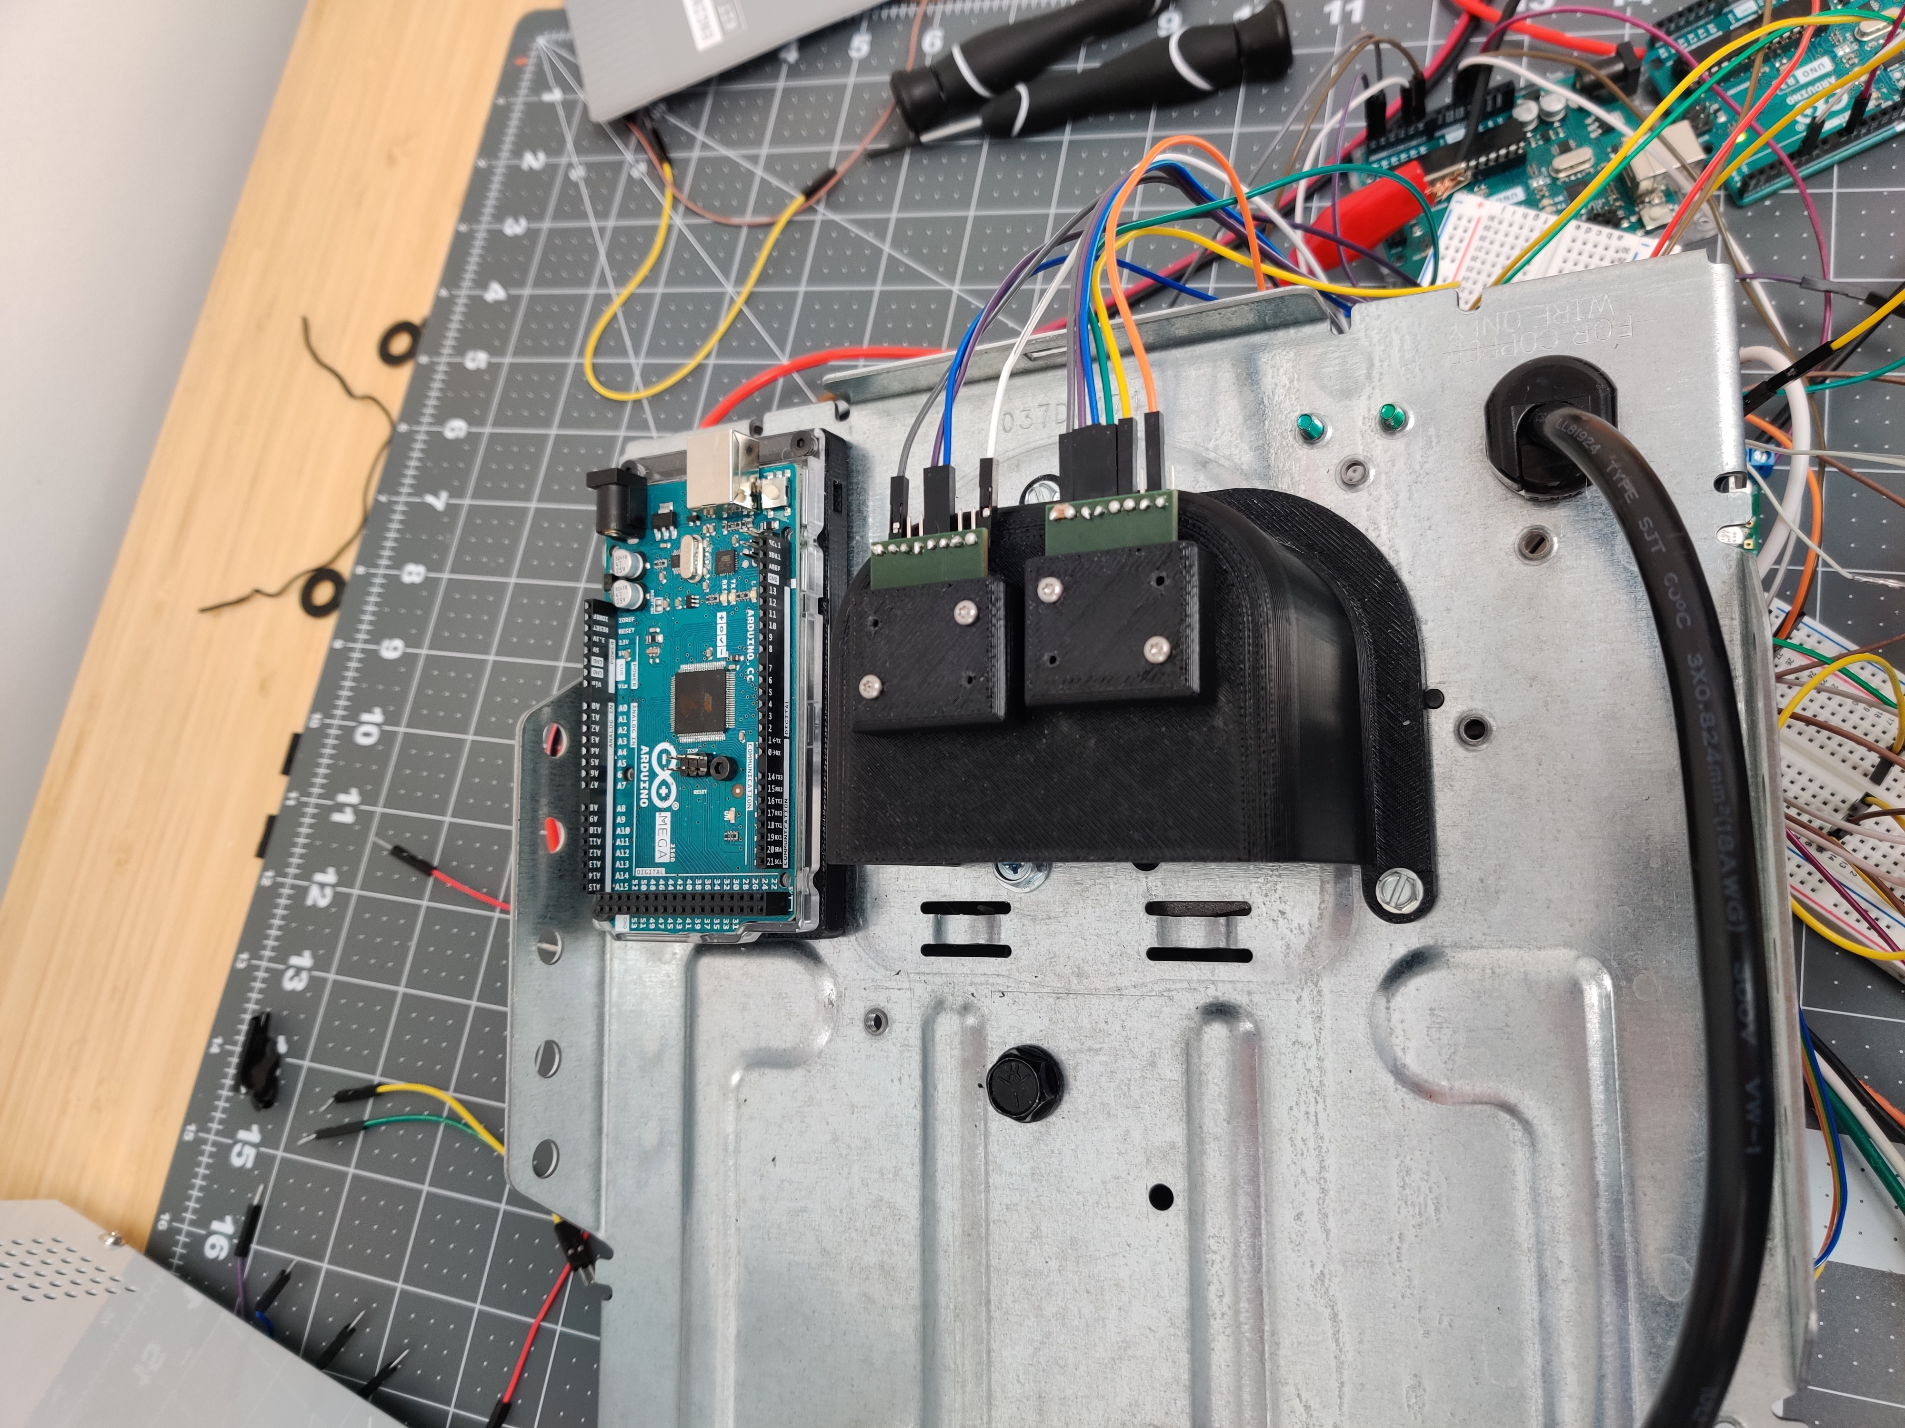
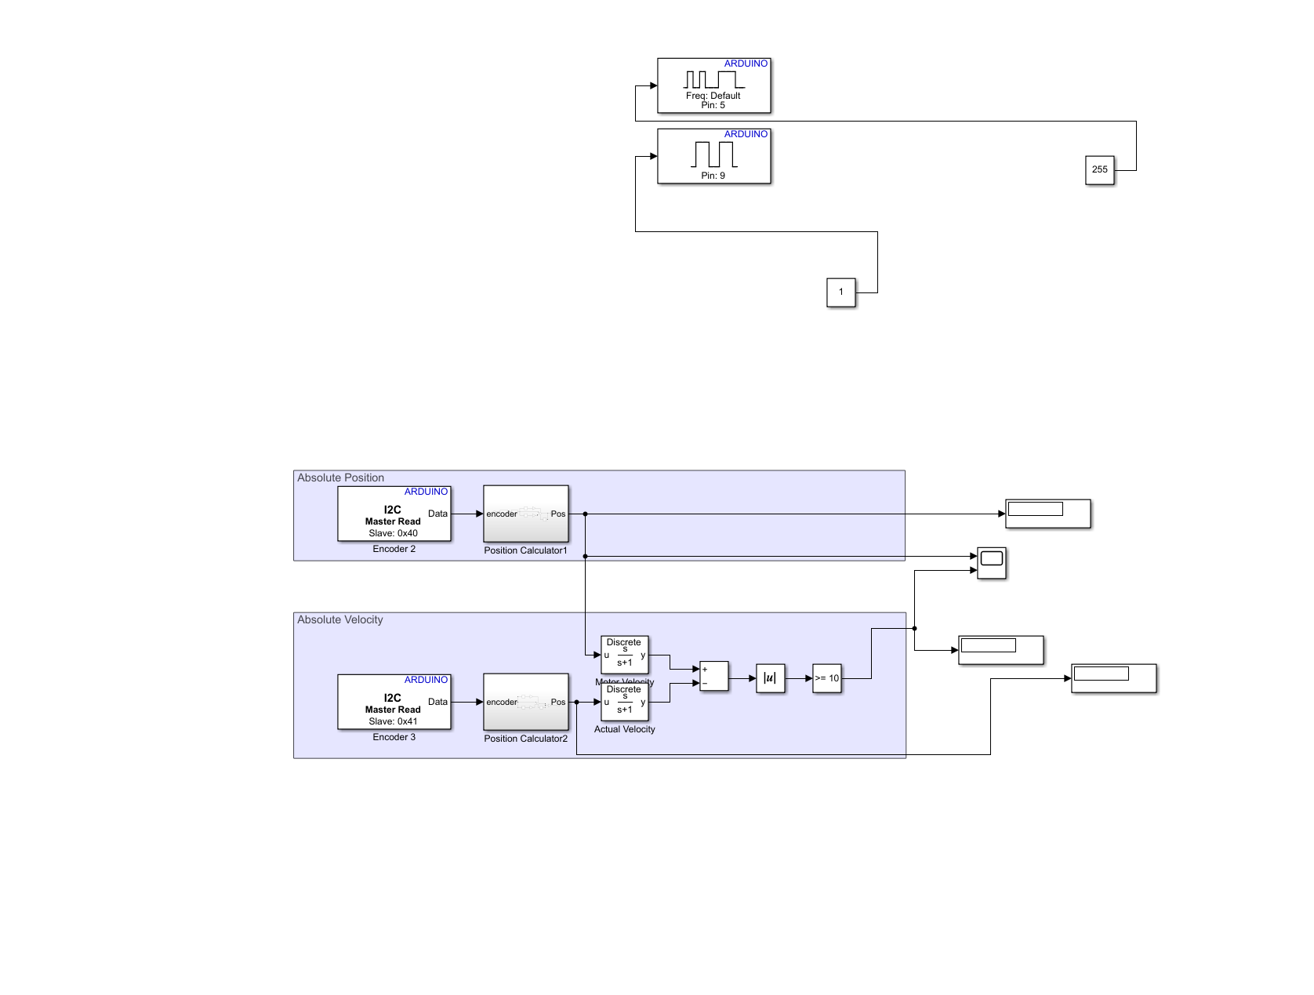
GARAGE OPERNER
Michael Haws
The garage door goes forward and backwards. The two encoders work. The gears slip a little will be investigating.

